Slide 1
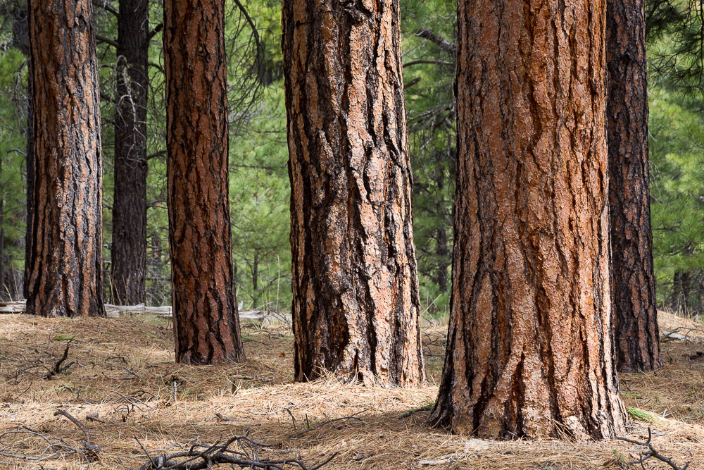
Monitoring drought stress in
Ponderosa Pine
AND WHITE
Notes:
Ponderosa pine is the iconic conifer species of the inland west, it dominates over 8 million hectares (20 million acres) of forested land in N. America. Its highly shade intolerant, fire resistant when mature, the most widely distributed pine in North America.

Slide 2
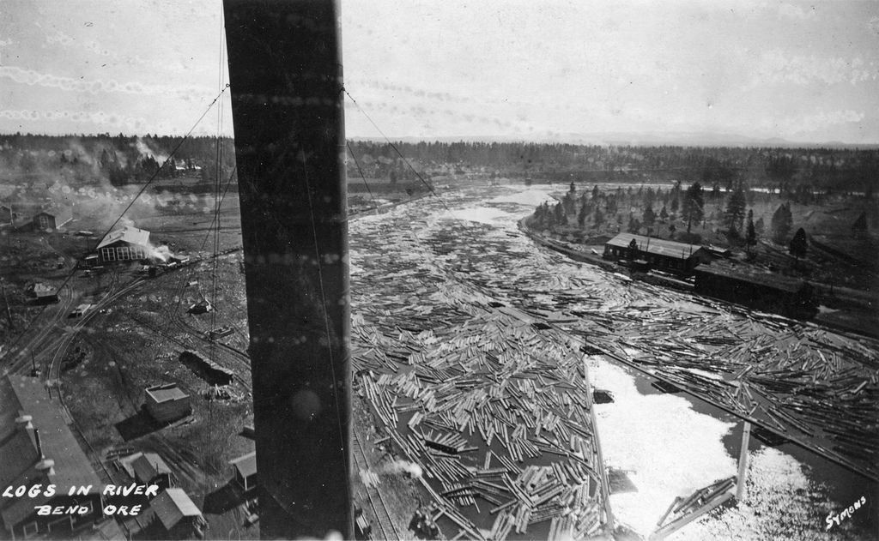
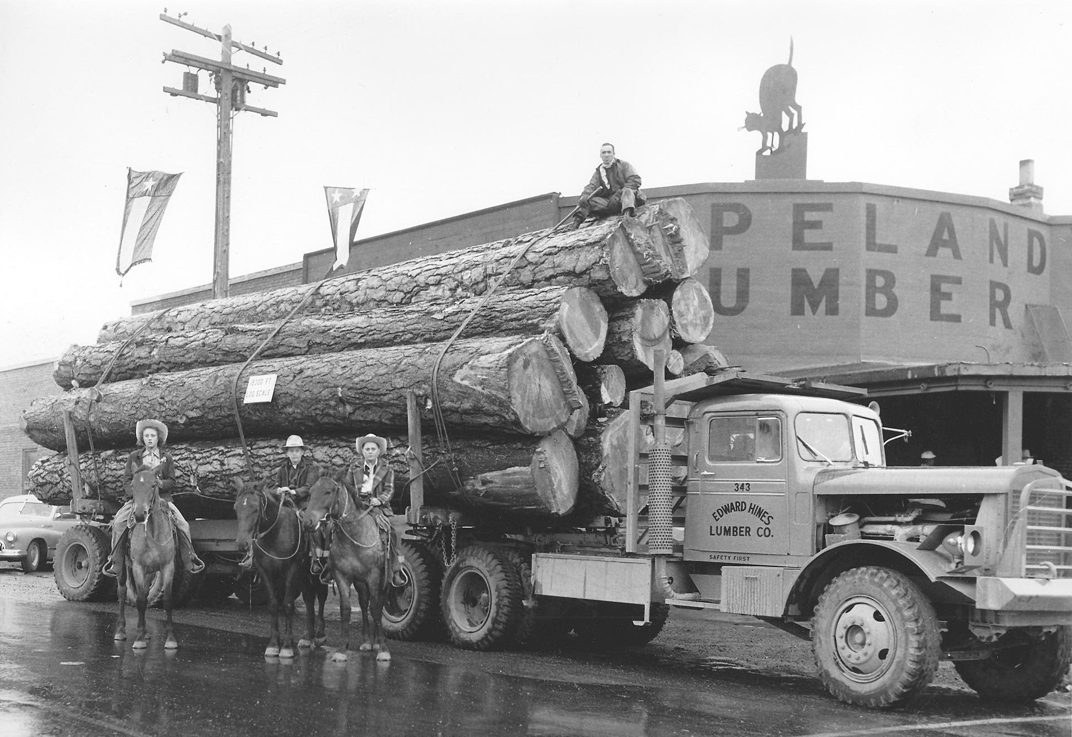
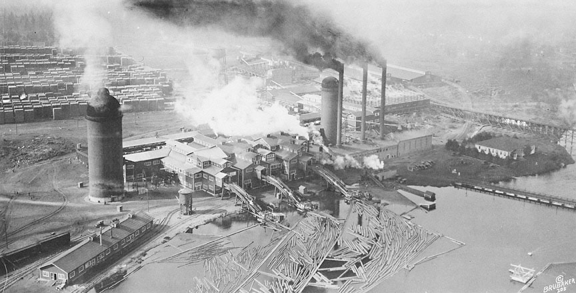
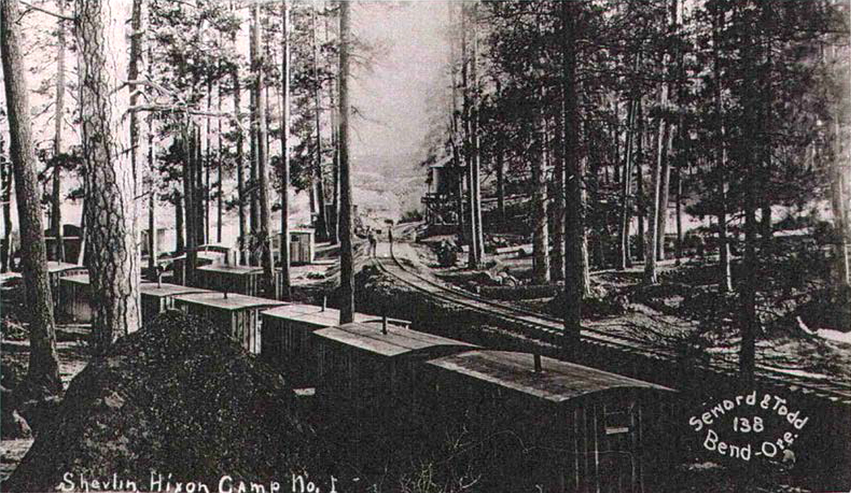
Notes:
Ponderosa pine was integral to the building of central Oregon. With the completion of the railroads in 1911 logging of Ppine began in earnest and lasted until the 1950’s when most of the accessible timber was exhausted.

Slide 3
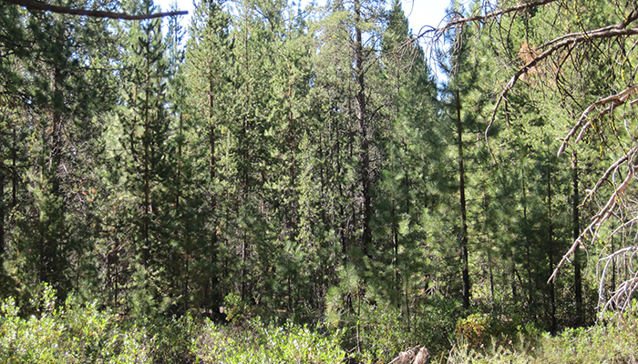
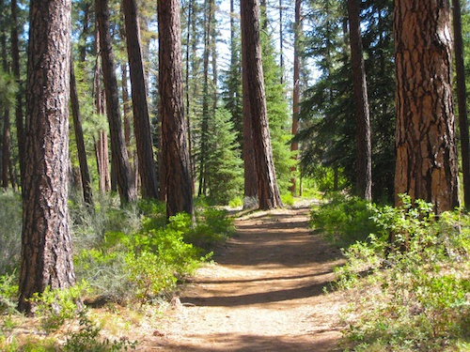
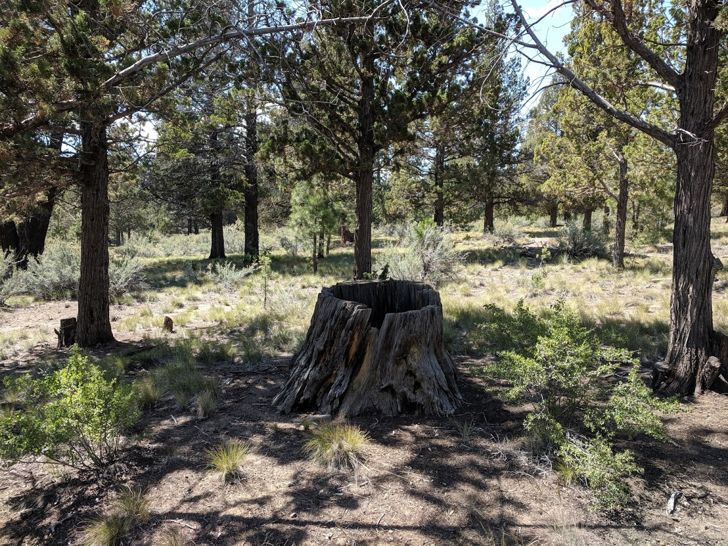
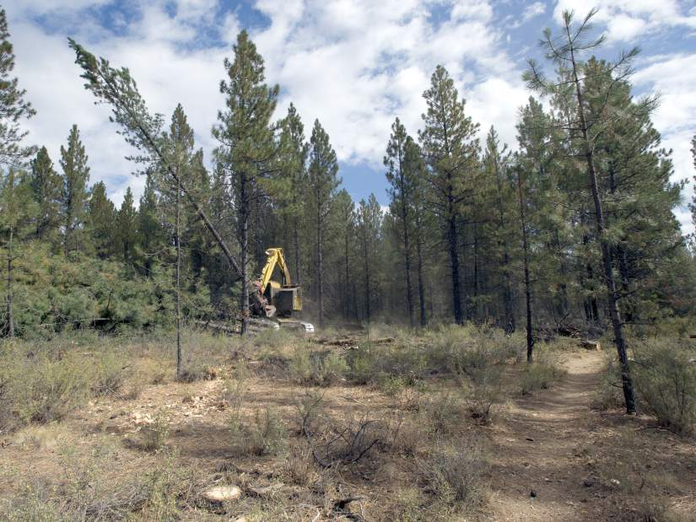
Notes:
By the mid 1950s most of the accessible large ponderosa pine were logged out in central Oregon. The pines that now dominate central Oregon regenerated after logging, and due to fire suppression developed into dense, fire prone stands.
The logging activity we see west of Bend is an effort to reduce catastrophic wildfire risk and promote the development of more open stands where fewer, larger trees dominate.

Slide 4
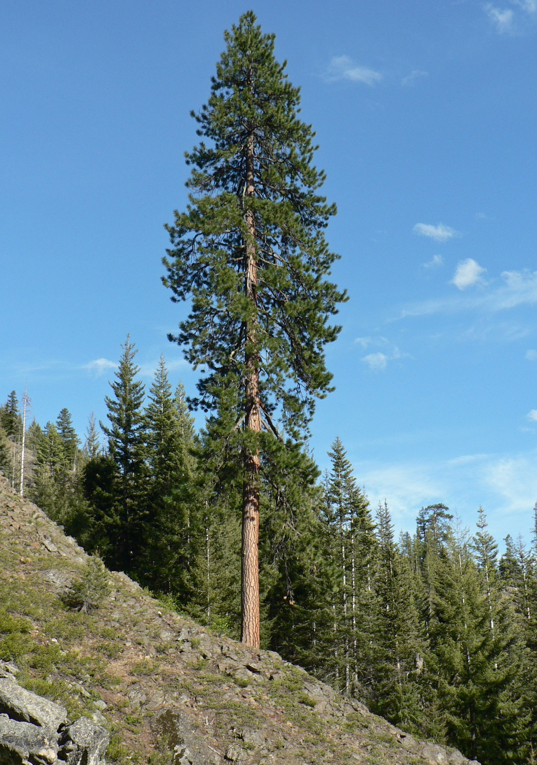
Near Infrared
Needles –
chlorosis
fade
drop
CO₂
Red
O₂
Thermal
H₂0
(C₆H₁₂O₆)
Insects and
disease
H₂0
H₂O
Notes:
Super simple diagram of photosynthesis and respiration. Soil moisture moves up the tree to the needles where the action happens – Carbon dioxide is absorbed from the atmosphere, O2 is released along with water. Water is the key to this process. Needles have tiny little openings called stomata. Ppine is highly sensitive to water availability and will close stomata to limit water loss and carbon uptake during drought stress.
Chlorosis – loss of chlorophyll due to nutrient deficiency, most often iron.
Oregon drought 2011 - 2017

Slide 5
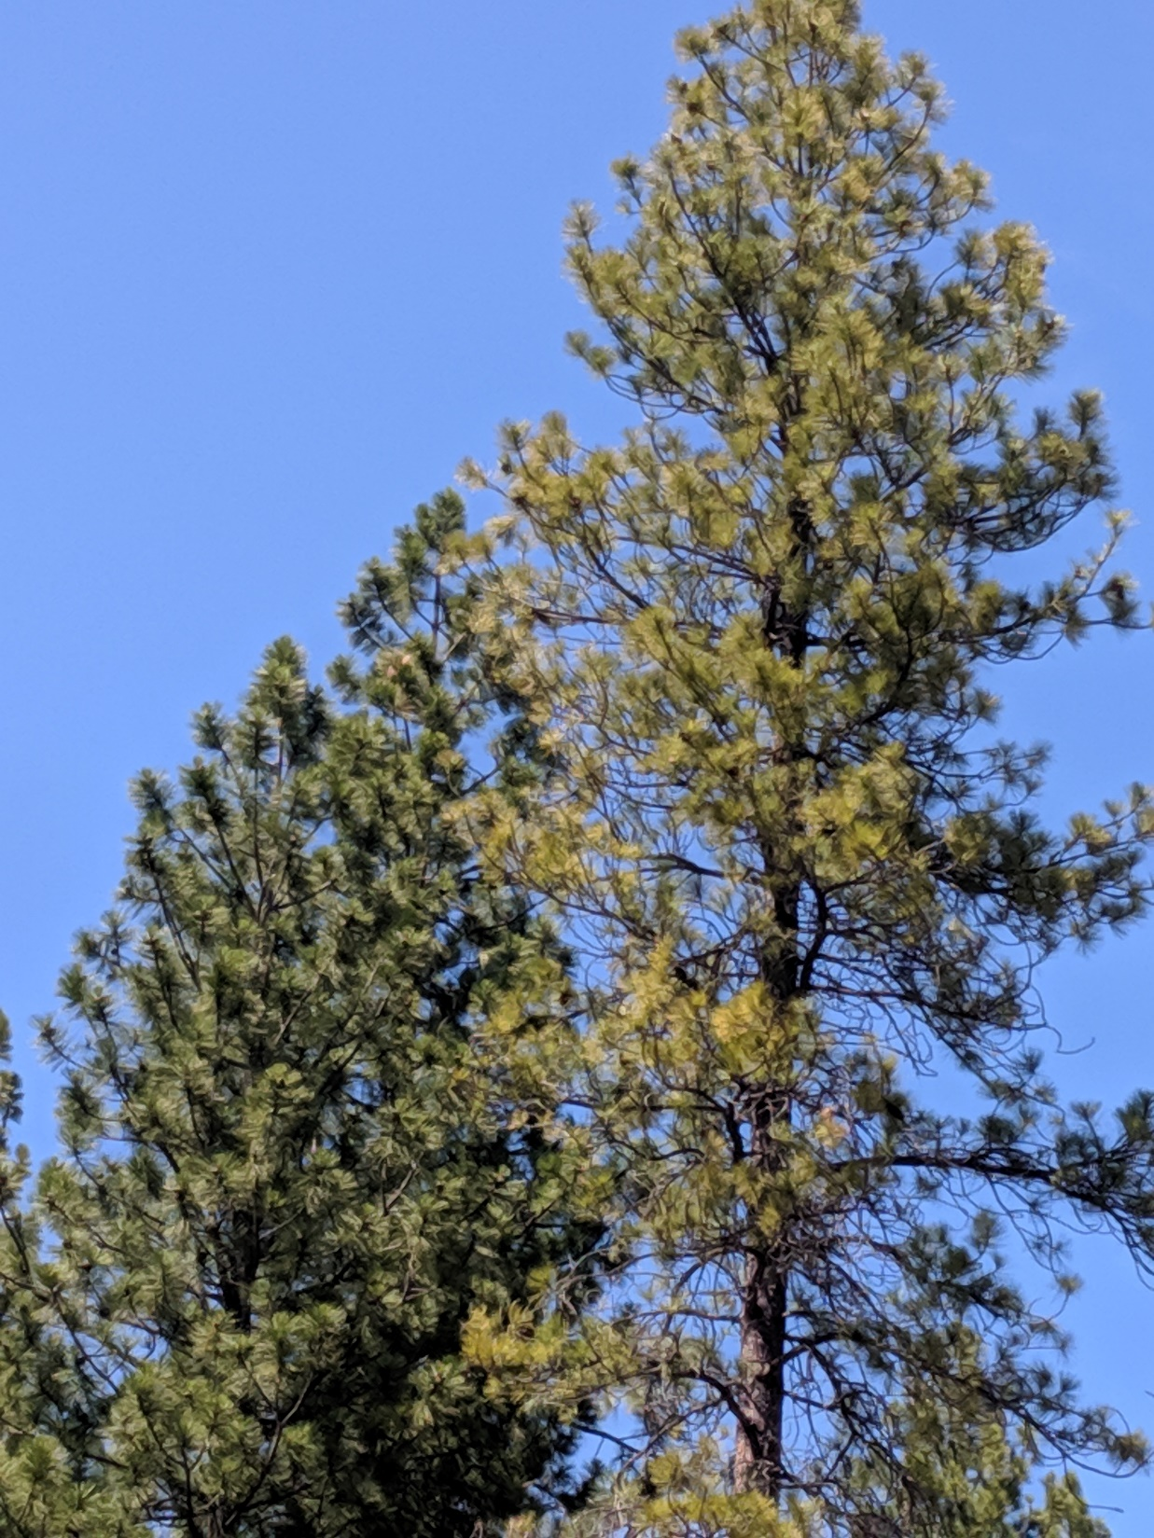
Notes:
Tree on right is chlorotic and low in needle mass, left tree is healthy.

Slide 6
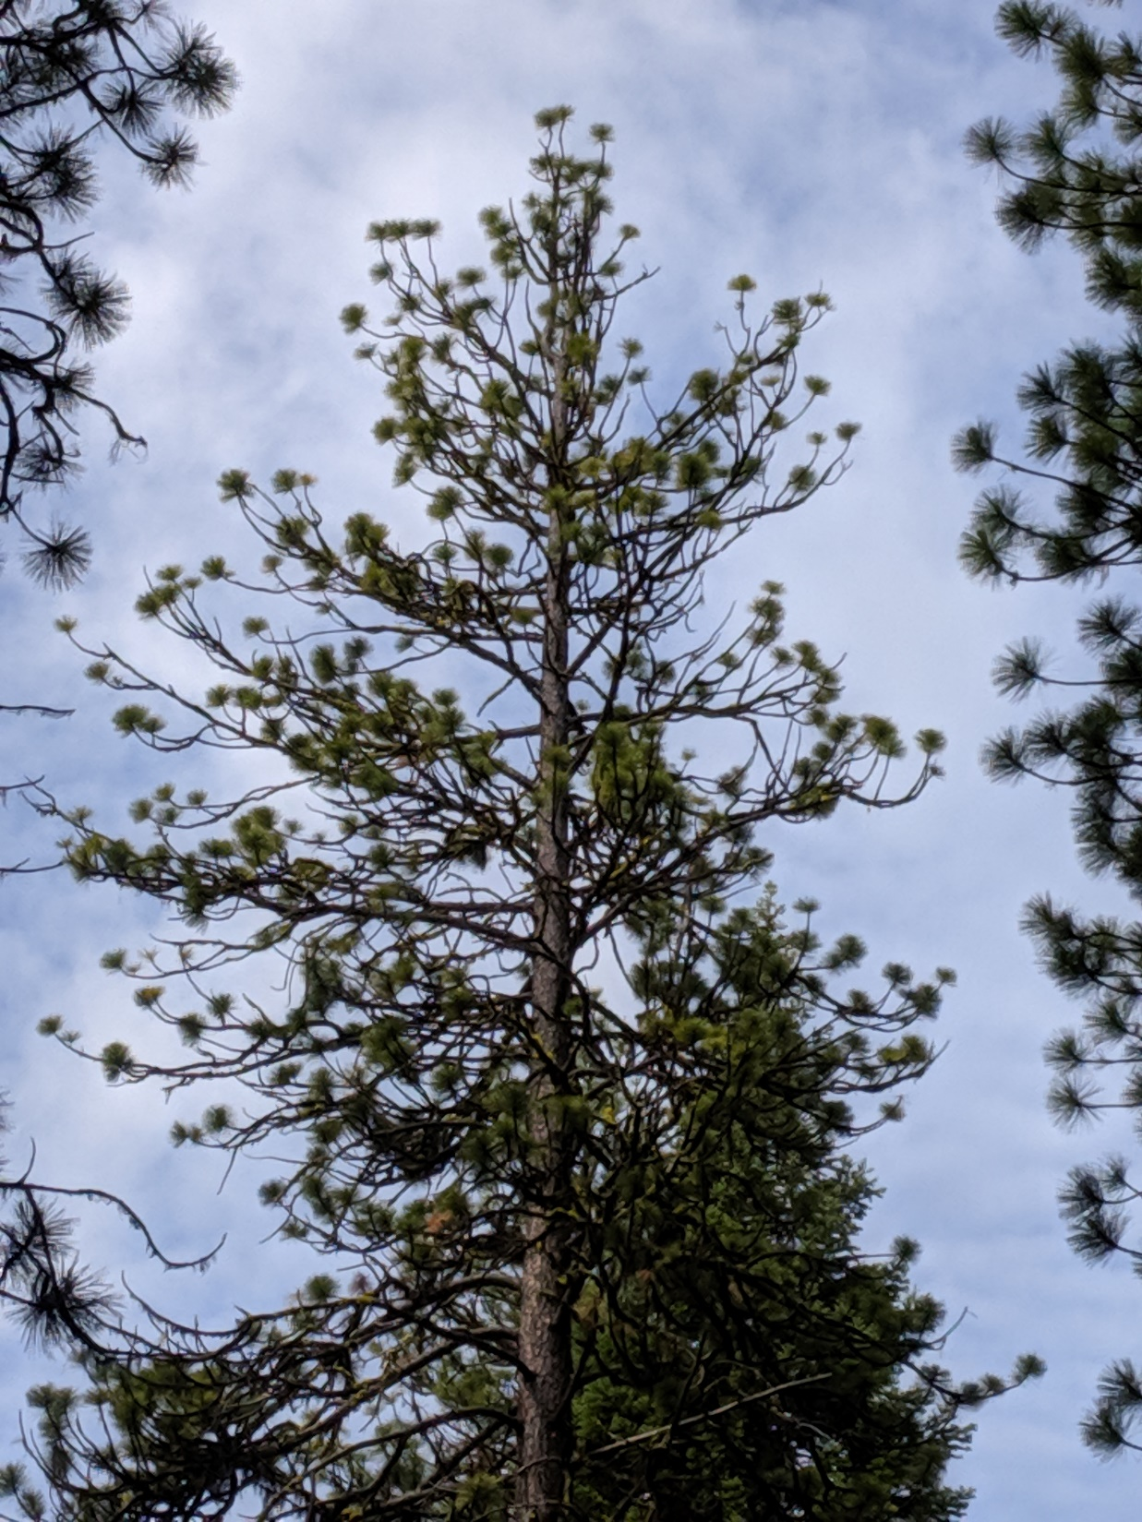
Notes:
Complete loss of older needle whorls (age classes) - poodling

Slide 7
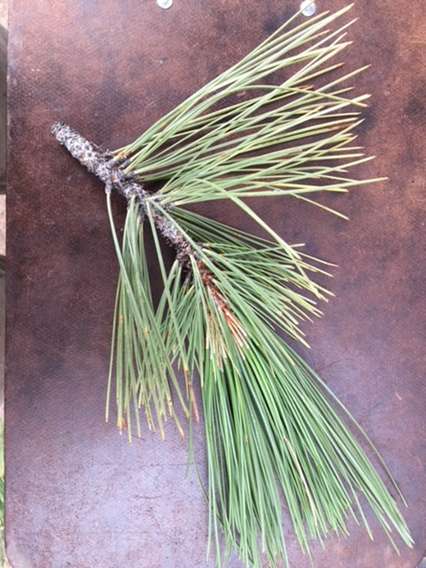
Notes:
Premature needle senescence – browning, fading. Typically needles are retained for 6 years, under drought stress these older needles fade and drop.

Slide 8
Monitoring PPine health
Why?
Selection of leave trees
Effectiveness of silvicultural treatments
Climate monitoring
Solution must be:
Easy to implement
Use standard data and software
Notes:
How can we use GIS/ RS to monitor the health of pine trees at both the tree and landscape level?
No boutique data or software, what can we do with standard stuff?

Slide 9
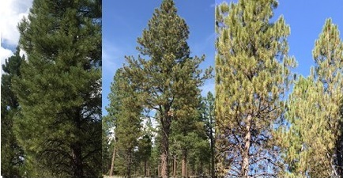
Notes:
We qualitatively classed trees as ‘above average’, ‘average’ or ‘poor’ in the field, then collected quantitative data - percentage of needle age classes that are chlorotic, years of needle retention, proportion of live canopy, and others.
Several of these variables were statistically different between the three vigor groups.

Slide 10
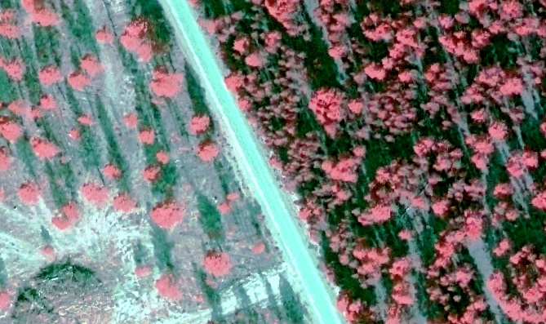
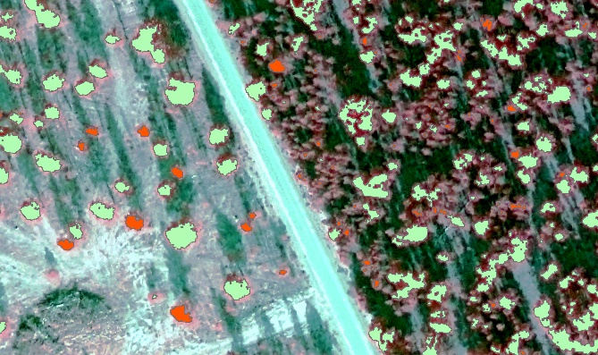
Monitoring PPine health
4-Band, 30cm imagery
Red, Green, Blue, Near-Infrared
Tree crowns as objects
Random Forests machine learning
Predictors – 11 spectral derivatives
NDVI, EVI, GCC, RCC, R, G, B, NIR
3 different silvicultural prescriptions, plus control
Notes:
Our approach used 4-band aerial imagery acquired thru the R6 Regional office. Next we segmented out the tree crowns using simple thresholding of the brightness and NIR bands.
Random Forests, an ensemble machine learning algorithm was used to build a model –the field assessed qualitative vigor class (not poor, poor) was the dependent variable while the spectra were the independent (predictor) variables.
There were three different treatments in the Sycan study area, plus unmanaged (control) sites.

Slide 11
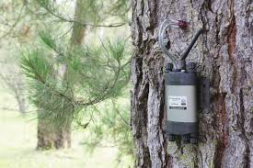
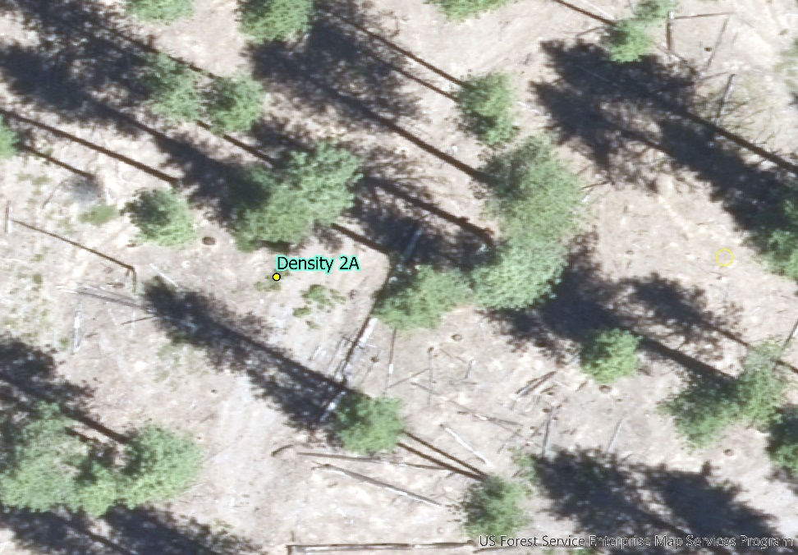
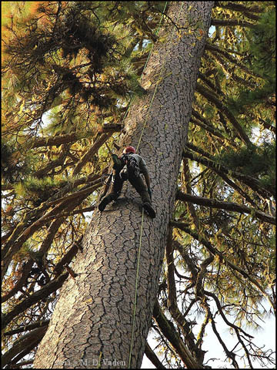
Notes:
Our current work is focused on the Pringle Falls Exp Forest south of Bend, where this summer we will employ several data collection methods, ranging from foliar and sap flow samples of individual trees to assessment of thermal
properties from the ECOSTRESS instrument on board the International Space Station.

Slide 12
USDA Forest Service
Western Wildlands Environmental
Threat Assessment Center
AND WHITE
Notes:
Thanks!! This is a project of the USDA Forest Service PNW Research Station and Western Wildlands Environmental Threat Assessment Center.

